Slide 1

METRO FRESH
Shrink Loss
Analysis
A Data-Driven Investigation into Inventory Shrinkage,
Loss Attribution & Strategic Recovery Pathways
BY: ESMERALDA OSEI

Slide 2

COMPANY OVERVIEW
Metro Fresh Enterprise
A multi-format convenience retail chain operating across diverse locations, stocking a wide range of goods across 15+ categories and serving thousands of daily transactions.
$8.88M+
Total Revenue
50+
Store Locations
15+
Product Categories
4
Store Formats
Store Network
Operations span Urban (48%), Suburban (35%), Highway (10%), and Rural (7%) formats — each presenting unique risk profiles.
Data Scope
Analysis covers inventory records, shrink transactions, shift logs, cause attribution, and category-level KPIs across the full period.

Slide 3
PROBLEM STATEMENT
Shrink & Loss Context
Metro Fresh is experiencing persistent inventory shrinkage across its store network, representing a material financial drain against total revenue. Despite recording over $8.88M in sales, shrink losses remain substantial and unevenly distributed — with no consistent, data-driven mechanism to identify, attribute, or reduce these losses.
Shrink Exceeds Target
Multiple high-value categories consistently breach shrink rate targets with no corrective action triggered.
Unclear Loss Attribution
Losses split across expiry, damage, theft, and staff consumption with no prioritised response framework.
Inventory Discrepancies
Large gaps between expected and actual SKU-level inventory signal systemic record-keeping or process failures.
Store-Level Concentration
A small subset of stores drives a disproportionate share of total shrink, indicating localised control gaps.

Slide 4
ANALYTICAL OBJECTIVES
Operational Research Framework
This analysis was designed to answer six core operational questions to drive strategic mitigation:
01. WHERE
Where is shrink happening?
Identify which stores, formats, and categories carry the highest loss burden.
02. WHY
Why is shrink happening?
Attribute losses by root cause: expiry, damage, theft, employee consumption.
03. WHEN
When does shrink peak?
Analyse daily and monthly trends to detect temporal patterns and spikes.
04. TARGETS
Are targets being met?
Compare actual vs target shrink rates across all product categories.
05. ACCURACY
Is inventory accurately tracked?
Assess record accuracy and variance between expected and actual stock levels.
06. ACTION
What actions can reduce loss?
Translate data findings into prioritised, actionable recommendations.

Slide 5
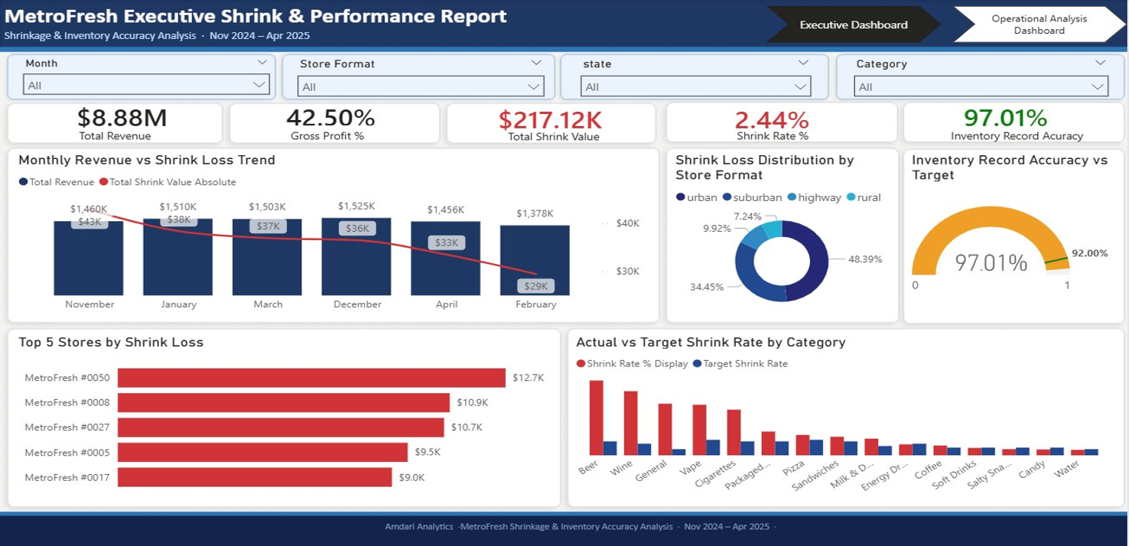
EXECUTIVE REPORT OVERVIEW

Slide 6
KPI Cards — Headline Performance Metrics
KPI
KEY FINDINGS
Total Revenue - $8.88M
Gross Profit Margin- 42.50%
Total Shrink Value- $217.12K
Shrink Rate- 2.44%
Inventory Record Accuracy- 97.01%
Revenue & Profit: $8.88M total revenue with 42.50% gross profit — the financial baseline against which all shrink impact is measured.
Total Shrink Value ($217.12K): Red conditional formatting is a direct visual alert. Executives immediately see that shrink has exceeded acceptable levels.
Shrink Rate (2.44%): 1.04pp above the 1.40% chain target and above the 1.8% industry benchmark. This confirms this is the core performance problem requiring prioritised action.
Inventory Accuracy (green — 97.01%): Green formatting confirms above the 92% target — one of the few positive signals on the dashboard.

Slide 7
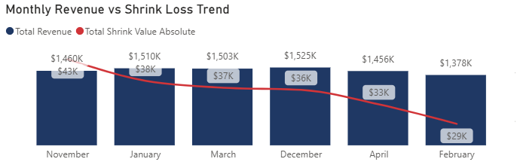
Monthly Revenue vs Shrink Loss Trend
TREND
KEY FINDINGS
Revenue Stability: Revenue ranged between £1.37M and £1.51M — relatively stable across the period.
Shrink Reduction: Shrink loss fell from £43K (Nov) to £29K (Feb) — a 33% reduction over 6 months.
Trend Analysis: The downward shrink trend is a positive signal but has not yet fully stabilized.
Risk Factors: Peak shrink in November aligns with high footfall, raising theft and expiry risk in busy periods.

Slide 8
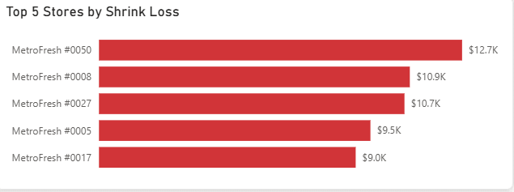
Top 5 Stores by Shrink Loss
STORES
KEY FINDINGS
Top Performer: MetroFresh #0050 is the highest-loss store at £12.7K — 41% more than the 5th-ranked store.
Concentration: The top 5 stores collectively drive a significant concentration of total network shrink.
Urgent Review: Stores #0008 and #0027 are closely matched at £10.9K and £10.7K — both require urgent review.
Insight: Loss concentration suggests controllable store-level process failures rather than systemic issues.

Slide 9
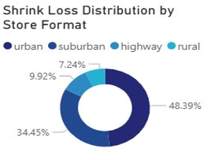
Shrink Loss Distribution by Store Format
FORMAT
ANALYSIS SUMMARY
Urban Dominance: Urban stores account for 48.39% of all shrink — the single largest segment in the network.
Suburban Volume: Suburban stores contribute 34.45%, reflecting higher transaction volumes in residential areas.
Minor Segments: Highway (9.92%) and rural (7.24%) formats show lower absolute loss but may have lower oversight.
Action Required: Urban shrink concentration warrants dedicated loss prevention resources in city-format locations.

Slide 10
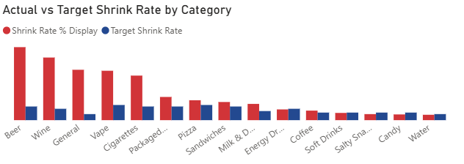
Actual vs Target Shrink Rate by Category
CATEGORY
KEY FINDINGS
High Theft Risk: Beer and Wine show the largest gap above target — both are high-value, high-theft categories.
Significant Breaches: General merchandise, Vape, and Cigarettes also significantly exceed their shrink rate targets.
Low Risk Areas: Water, Candy, and Salty Snacks are closest to or within target — lowest risk categories.
Network Health: 5 of 15 categories show persistent target breaches requiring category-specific interventions.

Slide 11
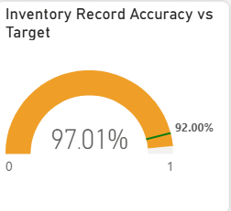
Inventory Record Accuracy vs Target
ACCURACY
KEY FINDINGS
Performance: Current inventory record accuracy stands at 97.01% — exceeding the 92% target by 5 points.
Reliability: One of the few strongly positive KPIs, suggesting the counting and recording process is reliable.
Confidence: High accuracy supports confidence that reported shrink figures reflect real losses, not data errors.
Maintenance: Maintaining this level requires consistent cycle counting discipline, especially in high-shrink stores.

Slide 12
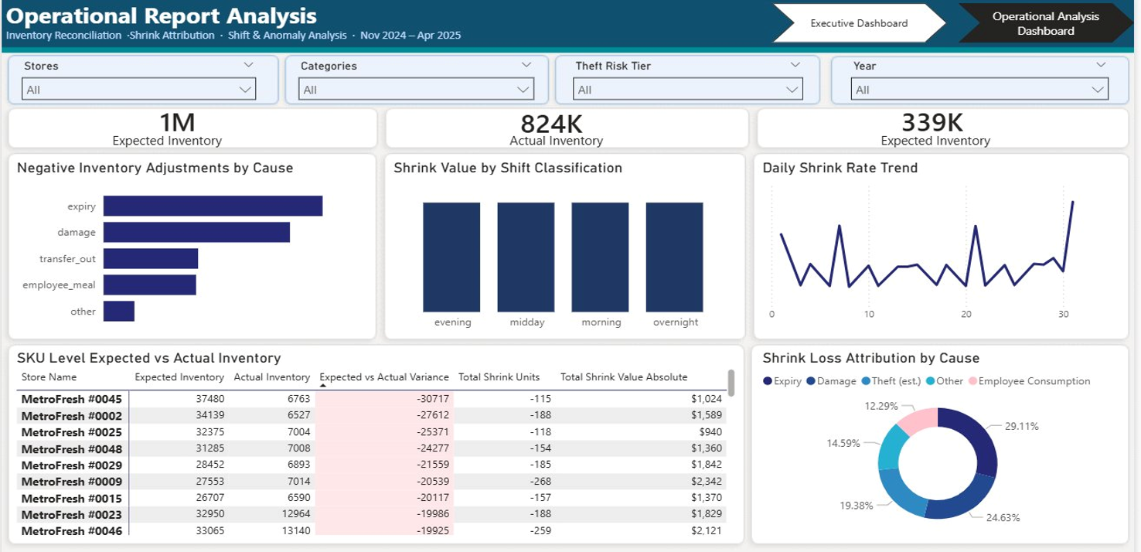
OPERATIONAL REPORT OVERVIEW

Slide 13
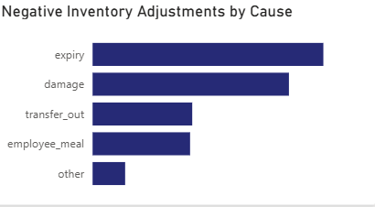
Negative Inventory Adjustments by Cause
ADJUSTMENTS
KEY FINDINGS
Expiry: Generates the highest volume of negative adjustments — far exceeding all other causes.
Damage: The second largest adjustment cause, consistent with the attribution chart findings.
Process Control: Transfer out and employee meal adjustments are mid-range — both controllable with process changes.
Reclassification: 'Other' adjustments are the smallest bucket but should be investigated and reclassified where possible.

Slide 14
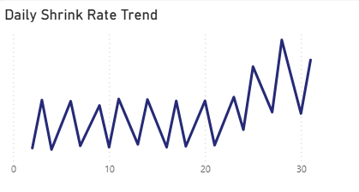
Daily Shrink Rate Trend
DAILY
KEY FINDINGS
Stable Trend: Shrink rate is broadly stable across days 1–25, oscillating within a consistent range.
Period Spike: A sharp spike is visible around day 30 — suggesting an end-of-period anomaly or reporting lag.
Cyclical Peaks: Secondary spikes around days 8 and 20 may correspond to product expiry batches or deliveries.
Alert Threshold: Daily alerts should trigger when shrink rate exceeds the observed baseline by more than 1.5×.

Slide 15
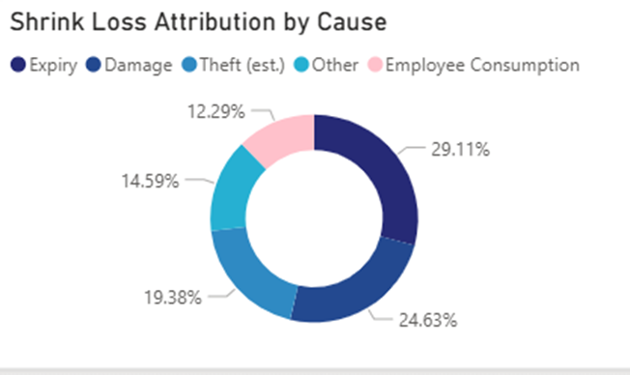
Shrink Loss Attribution by Cause
CAUSES
KEY FINDINGS
Expiry: Leading cause at 29.11% — indicating stock rotation and ordering process failures.
Damage: Accounts for 24.63% — the second largest contributor, linked to handling and storage.
Theft (est.): is the third largest at 19.38%.
Minor Causes: Other unclassified shrink sits at 14.59%.

Slide 16
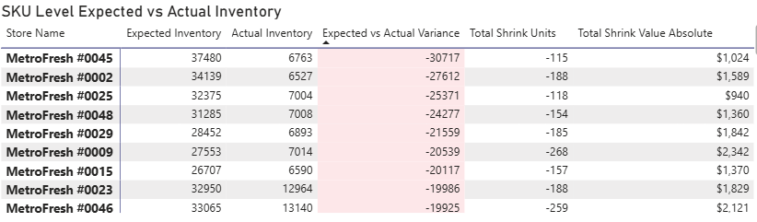
SKU Level Expected vs Actual Inventory
SKU
KEY FINDINGS
Max Variance: MetroFresh #0045 has the largest variance: -30,717 units between expected and actual inventory.
Systemic Loss: Negative variances are consistently large across the top stores, indicating systemic loss issues.
Highest Shrink: MetroFresh #0009 shows the highest shrink value (£2,342) despite not having the worst unit gap.
Targeted Focus: SKU-level monitoring should focus on stores with both large unit gaps and high £ shrink values.

Slide 17
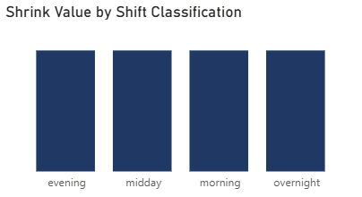
Shrink Value by Shift Classification
SHIFTS
KEY FINDINGS
Uniform Distribution: Shrink is distributed almost equally across evening, midday, morning, and overnight shifts.
No Vulnerability: No single shift carries a disproportionate share, ruling out a single-window vulnerability.
Overnight Risk: The overnight shift has fewer staff — making equivalent shrink there more operationally significant.
Data Correlation: Shift analysis should be cross-referenced with theft and employee consumption data for clarity.

Slide 18
INSIGHTS & RECOMMENDATIONS
HIGH
Address Expiry Losses
HIGH
Intervene in Top 5 Stores
Review ordering patterns for Beer, Wine & Vape. Implement FIFO strictly, add markdown triggers 48 hrs before expiry.
Deploy dedicated loss prevention audits at #0050, #0008 & #0027. Set store-specific shrink KPIs with weekly review.
HIGH
Strengthen Urban Controls
MED
Reclassify 'Other' Shrink
Urban stores carry 48% of shrink. Increase CCTV coverage, cycle counting frequency, and shift handover checks.
19% unclassified shrink limits response capability. Introduce mandatory sub-category coding at point of adjustment.
MED
Investigate Day 30 Spike
LOW
Sustain Accuracy Rate
The daily trend spike warrants root cause investigation — likely an end-of-period reporting or delivery event.
Inventory accuracy at 97% is a strong asset. Formalise the counting process to protect this KPI long-term.

Slide 19

METRO FRESH
Shrink Loss Analysis
Insights generated from November 2024 – April 2025 retail operations data.
THANK YOU.

